Slide 1

GNIOT
GROUP OF INSTITUTIONS
(Approved by AICTE & Affiliated to UPTU, Lucknow)
BTECH CSE-IoT 3rd Year (6th Semester)
loT LAB PROJECT
lot Based Smart Blind Stick
Under The Guidance Of
Mr. Gautam
Members:
Ayush Pandey(2101321550025) Ritesh Tiwari (2101321550048) Rohit Rishu (2101321550050)

Slide 2
Abstract:
This paper proposes an IoT-based smart blind stick designed to enhance navigation and safety for visually impaired individuals. Traditional blind sticks provide basic functionality for detecting obstacles, but they lack features that could improve user experience and safety in modern urban environments. Leveraging the capabilities of IoT technology, our smart blind stick integrates various sensors, connectivity options, and intelligent algorithms to offer advanced functionalities.
The core components of the proposed system include ultrasonic sensors, a microcontroller unit, and wireless communication modules such as Bluetooth or Wi-Fi. These sensors work in tandem to detect obstacles in the user's path and provide real-time feedback through haptic or auditory signals. Additionally, the GPS module enables location tracking, allowing users to navigate unfamiliar environments more confidently.
The IoT aspect of the system enables data collection and analysis in the cloud, facilitating personalized insights and continuous improvements to the device's functionality. Machine learning algorithms can be employed to analyse sensor data and predict potential obstacles or hazards based on historical patterns, further enhancing the user's safety.
Furthermore, the smart blind stick can be integrated with smartphone applications, providing additional features such as route planning, location sharing with trusted contacts, and emergency assistance. By leveraging the ubiquity of smartphones, the system enhances accessibility and ease of use for visually impaired individuals.
In conclusion, the IoT-based smart blind stick presented in this paper represents a significant advancement in assistive technology for the visually impaired. By integrating sensors, connectivity, and intelligent algorithms, it offers enhanced navigation, safety, and accessibility, empowering users to navigate the world with greater confidence and independence.

Slide 3
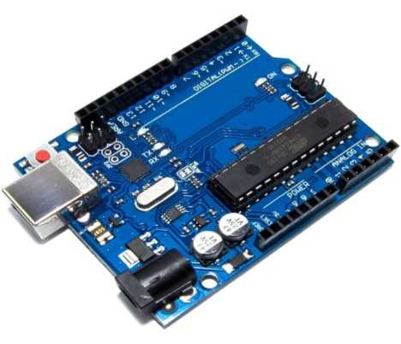
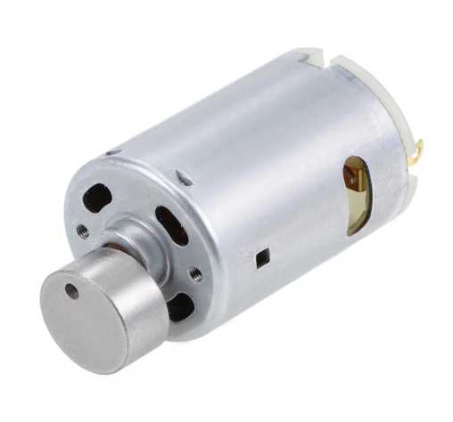
COMPONENTS :
The Arduino Uno, a popular microcontroller
board, has versatile applications:
1. | DIY Electronics Projects
2. | Home Automation
3. | IoT Development
4. | Robotics
5. | Education
6. | Wearable Technology
7. | Prototyping
8. | Art Installation
Atmega Micro-controller (Arduino)
Vibration motors are compact devices used for tactile feedback and alerts in various applications:
1. Mobile Devices
2. Wearable Technology
3. Gaming Controllers
4. Personal Electronics
5. Industrial Equipment
6. Medical Devices
7. Automotive
8. AR and VR
Vibration Motor

Slide 4
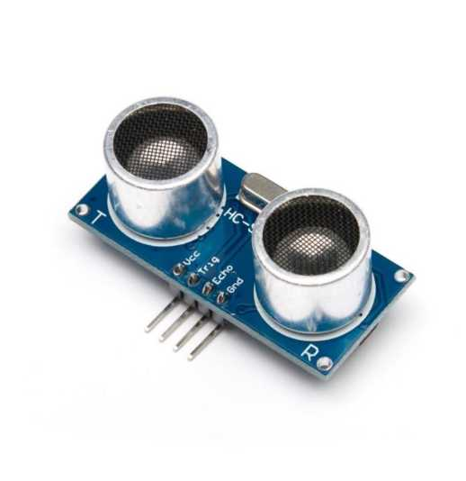
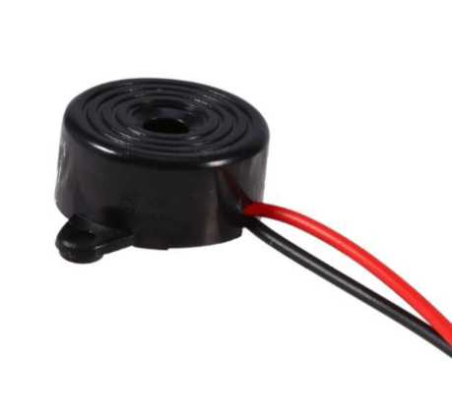
Ultrasonic sensors use high-frequency sound waves to measure distance or detect objects. Here's a brief overview of their applications:
1. Distance Measurement
2. Object Detection
3. Liquid Level Sensing
4. Obstacle Avoidance
5. Proximity Sensing
6. Flow Rate Measurement
7. Level Detection in Solids
8. Non-Destructive Testing
HC-SR04 Ultrasonic Sensor
Buzzer, an electromechanical device, is widely used for audible alerts and notifications in
applications such as:
1. | Alarm Systems
2. | Indicators
3. | Feedback Systems
4. | Notification Systems
5. | Fault Alarms
6. | Warning Signals
7. | Educational Tools
8. | Confirmation Signals
Buzzer

Slide 5
Application :
> Obstacle detection and navigation using sensors.
> Smartphone integration for GPS navigation and voice assistance.
> Real-time environmental monitoring for air quality, temperature, etc.
> Crowd monitoring to navigate through crowded areas safely.
> Remote monitoring for caregivers to ensure user safety.
> Data analytics to improve device design and urban accessibility.
> Integration with smart city infrastructure for seamless navigation.

Slide 6
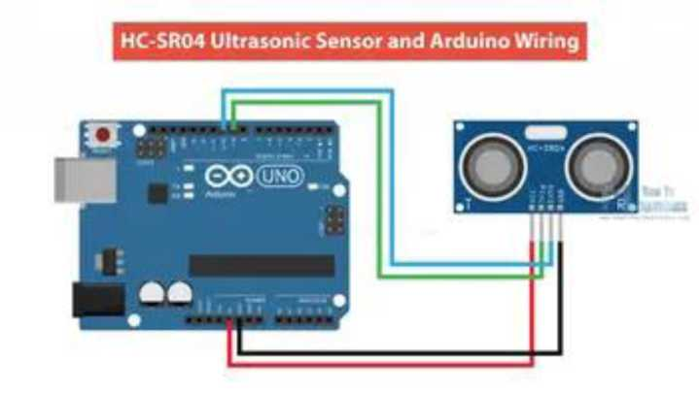
INTERFACING WITH ARDUINO
ULTRASONIC SENSOR (Circuit Diagram & Code)
#define ECHO_PIN 2 #define TRIG_PIN 3
void setup() {
Serial.begin(115200); pinMode(LED_BUILTIN, OUTPUT); pinMode(TRIG_PIN, OUTPUT); pinMode(ECHO_PIN, INPUT);
}
float readDistanceCM() { digitalWrite(TRIG_PIN, LOW); delayMicroseconds( 2); digitalWrite(TRIG_PIN, HIGH); delayMicroseconds( 10); digitalWrite(TRIG_PIN, LOW); int duration = pulseIn(ECHO_PIN, HIGH); return duration * 0.034 /2;
}
void loop() {
float distance = readDistanceCM(); bool isNearby = distance < 100; digitalWrite(LED_BUILTIN, isNearby); Serial.print("Measured distance: "); Serial.prin tln(readDistanceCM()); delay(100);
}

Slide 7
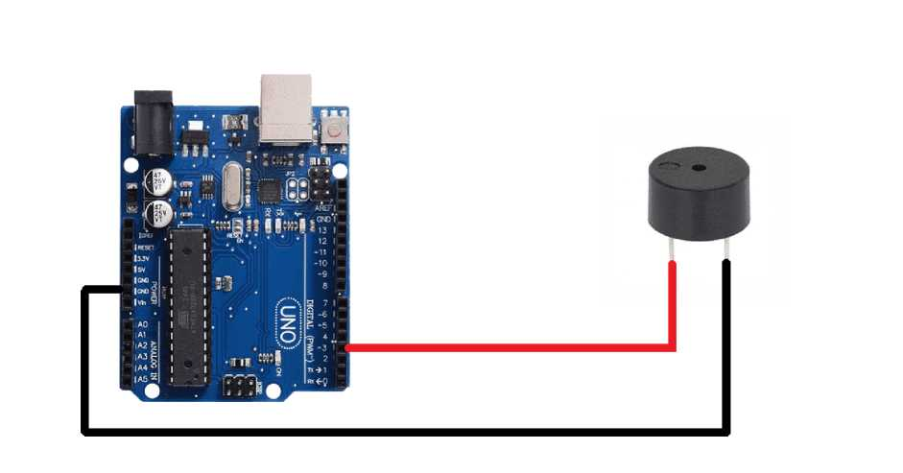
BUZZER (Circuit Diagram & Code)
const int buzzer = 9; void setup(){
pinMode(buzzer, OUTPUT); }
void loop(){ tone(buzzer, 1000); delay(1000); noTone(buzzer); delay(1000);
}

Slide 8
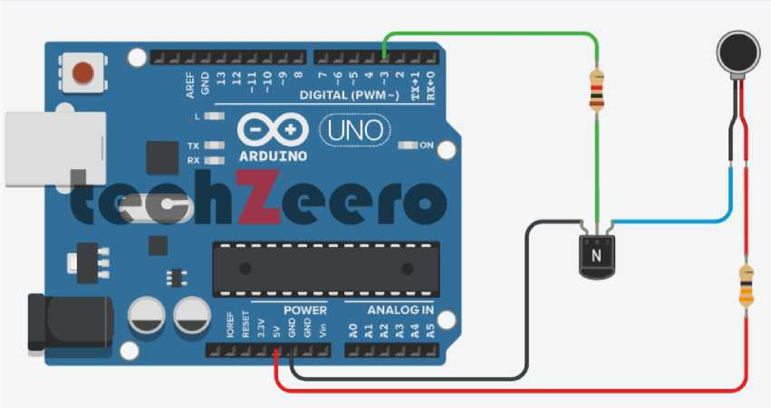
VIBRATION MOTOR (Circuit Diagram & Code)
int motorPin = 3; //motor transistor is connected to pin 3 void setup()
{
pinMode(motorPin, OUTPUT);
}
void loop()
{
digitalWrite(motorPin, HIGH); //vibrate delay(1000); // delay one second digitalWrite(motorPin, LOW); //stop vibrating delay(1000); //wait 50 seconds.
}

Slide 9
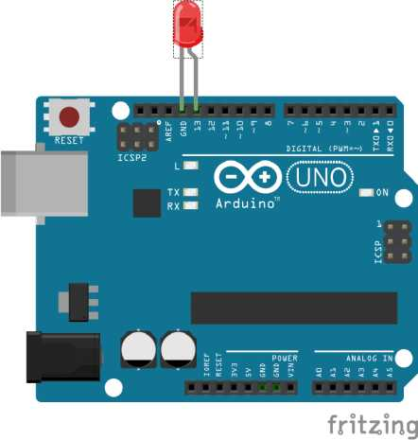
LED (Circuit Diagram & Code)
void setup() {
//put your setup code here, to run once: pi nMode(8,HIGH);
}
void loop() {
//put your main code here, to run repeatedly: digi tal Wri te(8, HIGH);
}

Slide 10
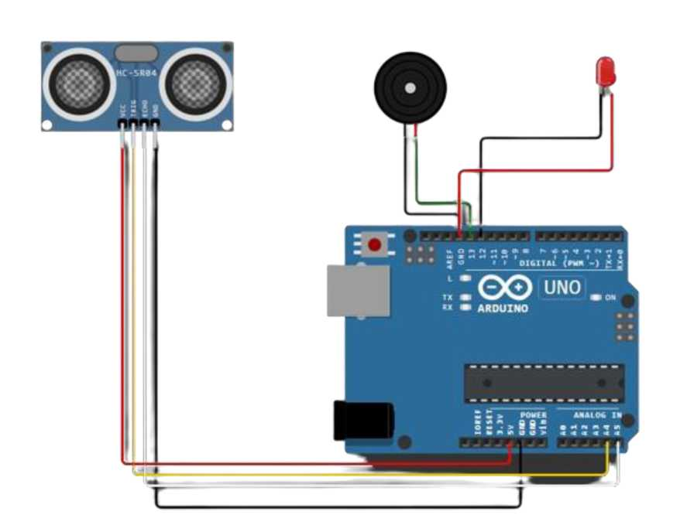
FINAL CIRCUIT DIAGRAM WITH CODE
const intpingTrigPin = A4; //Trigger connected to PIN 7
const intpingEchoPin = A5; //Echo connectedyo PIN 8
const int ledPin = 12;
int buz=13; //Buzzer to PIN 4
int buz1=9;
int motorPin = 3; //motor transistor is connected to pin 3
void setup() {
Serial.begin(9600); pinMode(buz, OUTPUT); pinMode(buz1, OUTPUT); pinMode(ledPin, OUTPUT); pinMode(motorPin, OUTPUT);
}
void loop() { long duration, cm; pinMode(pingTrigPin, OUTPUT); digitalWrite(pingTrigPin, LOW); delayMicroseconds(2); digital Write(pingTrigPin, HIGH);

Slide 11
delayMicroseconds(5); digitalWrite(pingTrigPin, LOW); pinMode(pingEchoPin, INPUT);
//Vibration Motor
digitalWrite(motorPin, HIGH); //vibrate delay(1000); // delay one second digitalWrite(motorPin, LOW); //stop vibrating delay(1000); //wait 50 seconds.
duration = pulseIn(pingEchoPin, HIGH); cm = microsecondsToCentimeters(duration); if(cm<=100 && cm>0)
{
int d = map (cm, 1, 100, 20, 2000); digitalWrite(buz, HIGH); digitalWrite(buz1, HIGH); delay(50);
digitalWrite(buz, LOW); digitalWrite(buz1, LOW); delay(d);
digitalWrite(ledPin, HIGH);
}
else {
digitalWrite(ledPin, LOW);
}
Serial.print(cm);
Serial.print(”cm”);
Serial.println();
delay(40);
}
long microsecondsToCentimeters(long microseconds) {
return microseconds / 29 / 2;
}

Slide 12
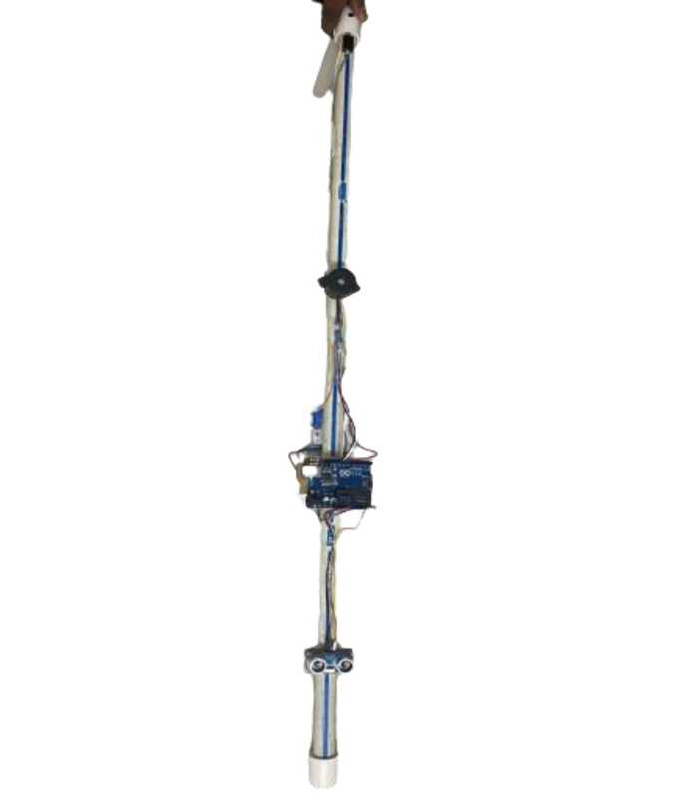
PROTOTYPE DIAGRAM:
GOOGLE DRIVE LINK:
https://drive.google.eom/file/d/1iGezCmTB6Enz58kJN23V TS6Cj7si9AE/v iew?usp=drive link

Slide 13
Reference :
https://circuitdigest.com/microcontroller-proiects/arduino-smart-
blindstick#:~:text=The%2QLDR%20is%2Qconnected%2Qwith,r
emote%20circuit%20is%20shown%20below.
https://techatronic.com/smart-blind-stick-using-arduino-and-
ultrasonic-sensor/
https://www.academia.edu/download/6561Q658/BQ9Q1Q914.pdf
https://www.researchgate.net/publication/343186221 Smart Sti ck For the Blind Using Arduino

